Slide 1

Hate Speech Detection
Virtual Internship
01-09-2023

Slide 2
Introduction
Hate Speech has been recently increasing on social media platforms.
Hate speech is targeting groups with different:
Race
Ethnicity
Color
Background
Religions
Ancestry
Sex
Nationality
Tweeter is one of the main platforms with high hate speech recognition.
It is believed that such issue can result in the increase of hate and violence towards the mentioned group
It is believed that the targeted groups are more likely to suffer emotional and mental damage due to the increased hate towards them.
Hate speech adds more stress in the targeted groups life making it more difficult on them to live normally.

Slide 3
Proposed Solution
It is believed that such issue could be tackled with the integration of an automatic hate speech detector.
Such detector would be capable of:
Automatically scanning the tweets posted instantly
Identify the hate targeted tweet to remove it.
To create such system, it is believed that integration of Deep Neural networks is needed.
Several systems are available to accomplish the task such as Word2Vec and GloVe.
However, it is believed that a Transformer Model such as BERT would be best.
Implementation of BERT (Transformer) Model is beneficial as it:
Is a contextual model that assess the relation ship between each word in a bidirectional way
It assess the relationship between the word and its previous and its next word.

Slide 4
Profit Analysis
Methodology
To implement BERT, a dataset was needed to train it on Tweeter tweets.
A dataset was downloaded from Kaggle as it included tweeter tweets with identification of its intentions.
The dataset needed refinement to prepare it for model training.
A pretrained model for BERT was downloaded
The downloaded model was the basic uncased version as it didn’t require high computation power.
Rectified linear activation function was used to help set the results above a threshold (Zero).
SoftMax activation layer was also used to transform output of the model into vector of probabilities.
Dataset was divided into 70-30 percentage ratio after refinement to train, evaluate and test the model.
The testing dataset was divided into 50-50 percentage ratio between testing and evaluating.
BERT uses a tokenizer method to identify every word in a sentence and add positional indices to it.
Model was trained for 15 epochs and results were acquired

Slide 5
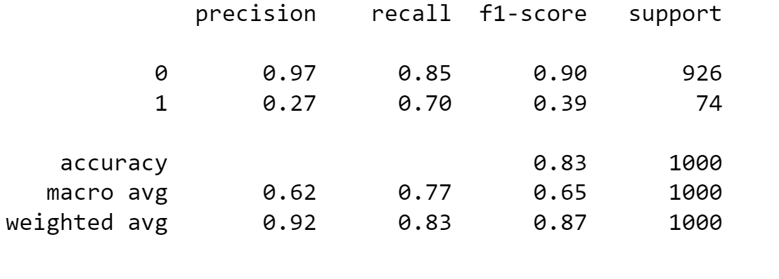
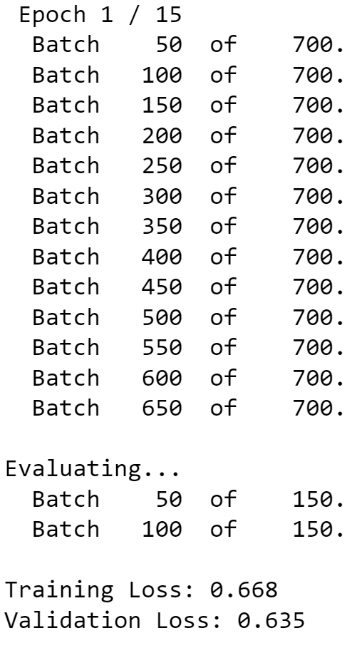
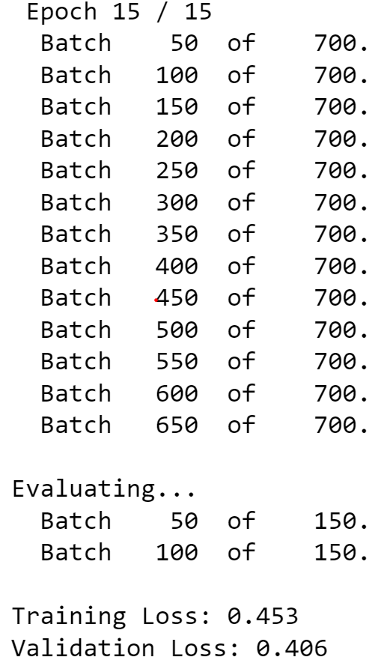
Results
During Training
Trained model produced remarkable outcomes when tested
The training total loss percentage (error) decreased from 0.668 to 0.453 in just 15 epochs
The validation total loss percentage decreased by 0.257 in 15 epochs reaching 0.4 error percentage as shown in figure 2.
Prediction results after training
Testing dataset contained 1000 tweets in which the model was able to:
Detect that 97% of the dataset is normal speech
Overall weighted average accuracy is 92% as shown in figure 1.
Figure 1: test results of BERT training
Figure 2: training epochs

Slide 6
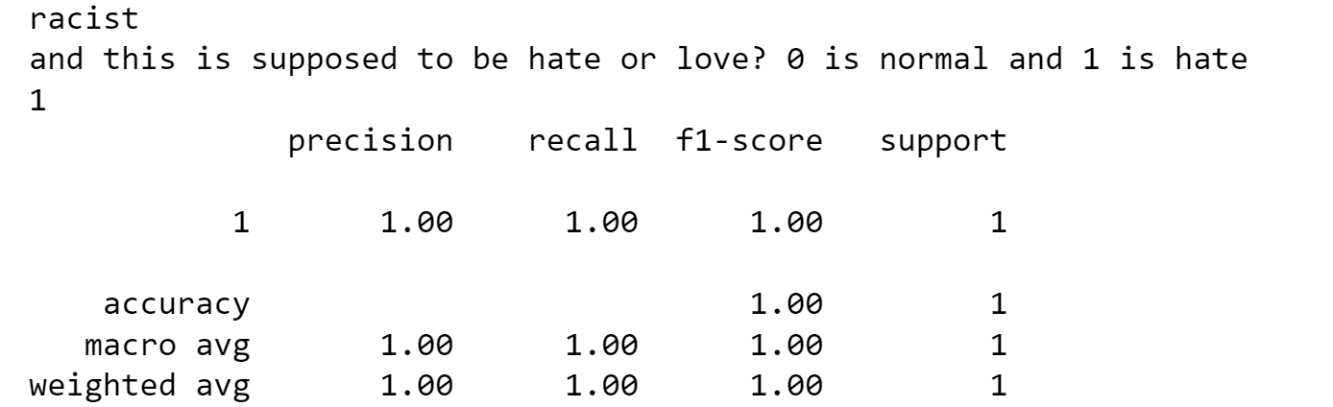
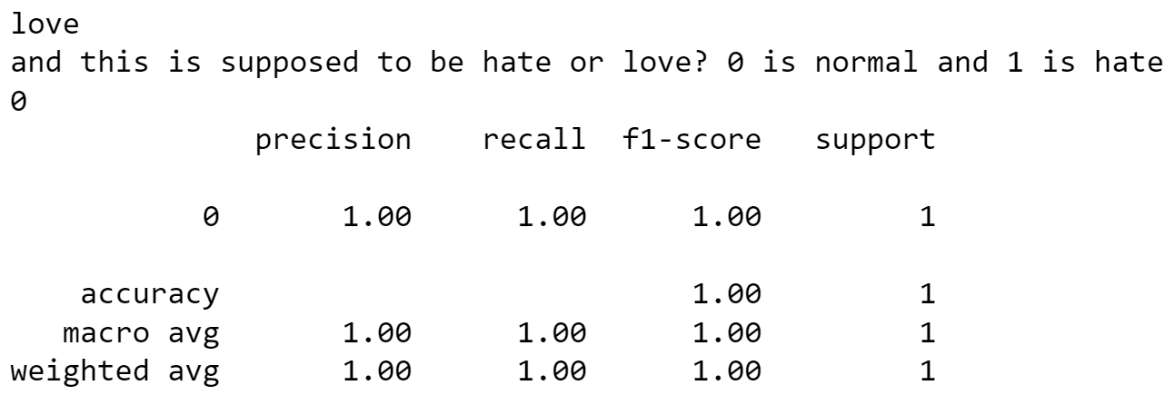
Conclusion
This presentation introduced the hate speech detection issue proposed, proposed solutions to the issue, and implementation of the solution alongside testing it.
Overall, the model was able to accurately detect any hate speech/words as illustrated in figure 3 and 4.
The model proved its ability to be implemented for such task through its significant results.
Figure 3: using a hate word to access the model prediction( result 1 equal hate speech)
Figure 4: testing on a normal word

